Slide 1
FLASH CARD PRESENTATION
Chapter 18

Slide 2
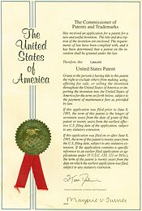
patent
A document giving someone the sole right to make and sell an invention.

Slide 3
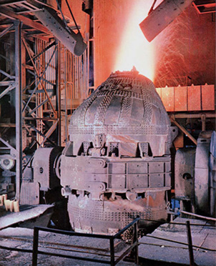
Bessemer process
The method developed in the 1850s to make stronger steel at a low cost. It helped make steel the basic building material of cities and industry.

Slide 4
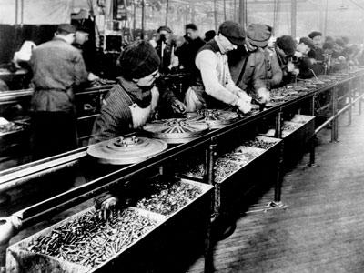
assembly line
The manufacturing method in which a product is put together as it moves along a belt. This method speeds production and lowers costs.

Slide 5
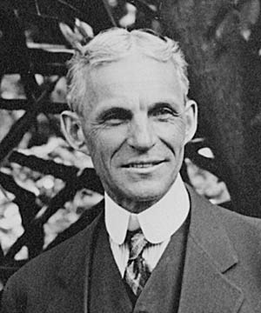
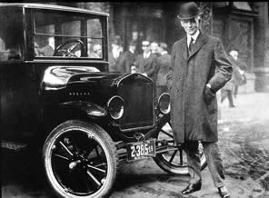
Henry Ford
The American manufacturer that made the automobile available to millions of people by perfecting a system to mass-produce cars (assembly line) and made them available at a lower price.

Slide 6
consolidate
To combine or merge together.

Slide 7
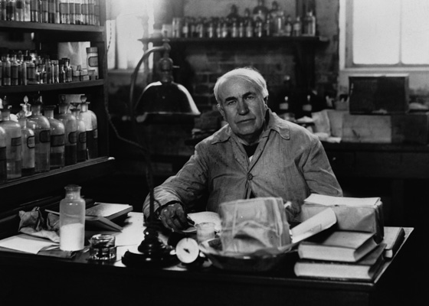
Thomas Edison
His “invention factory” produced the light bulb, the phonograph, the motion picture camera, and hundreds of other devices. He also opened the first electric power plant in New York City.

Slide 8
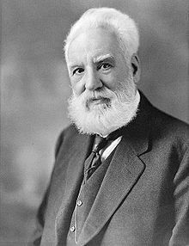
Alexander Graham Bell
He invented the telephone in 1876 and later organized over 100 local companies into the giant American Telephone and Telegraph Company.

Slide 9
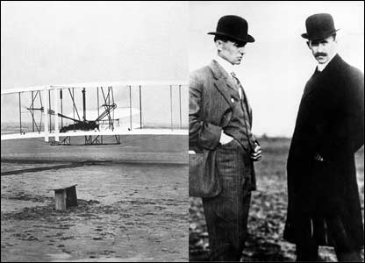
Orville and Wilbur Wright
They invented the airplane in 1903. This marked a revolution in transportation but would not alter the world until the 1920’s.

Slide 10
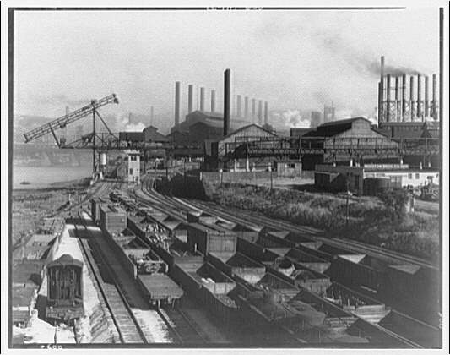
industrialization
The process in which a country transforms itself from a primarily agricultural society into one based on manufacturing of goods and services.

Slide 11
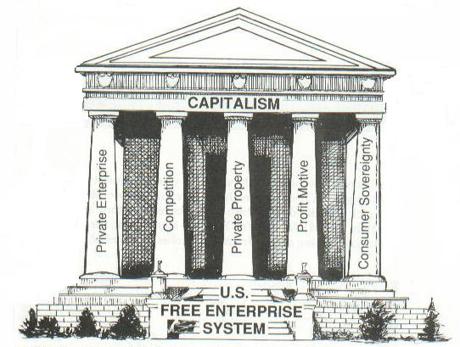
free enterprise (capitalism)
The economic system in which privately owned businesses compete in a free market.

Slide 12
entrepreneur
Someone who takes the risks associated with setting up new businesses in order to make a profit.

Slide 13
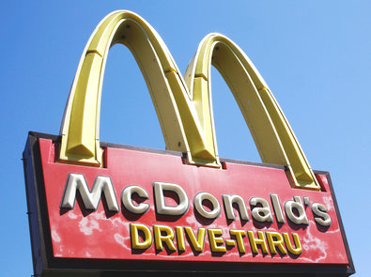
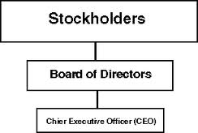
corporation
A business that sells stock in order to raise large sums of money quickly; owned by many investors.

Slide 14
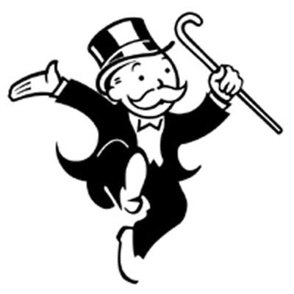
monopoly
A company that controls most or all the business of an industry with the purpose of reducing competition

Slide 15
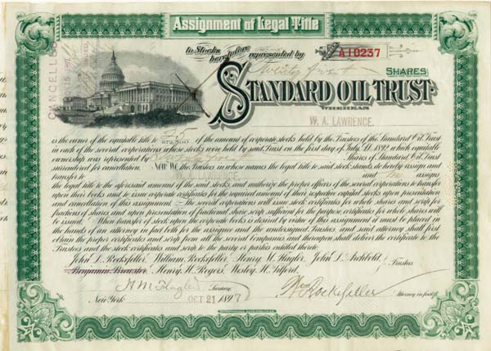
trust
The combination of corporations joining together to limit competition within an industry; an industry wide-monopoly.

Slide 16
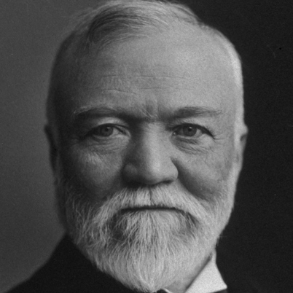
Andrew Carnegie
The giant of big business that came to dominate the steel industry by gaining control of every step in making steel. He could be ruthless as a business leader, but still believed the rich had a duty to improve society.

Slide 17
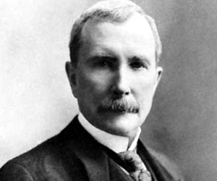
John D. Rockefeller
The business giant who ended competition in the oil industry by slashing prices to drive rivals out of business and formed the Standard Oil Trust.

Slide 18
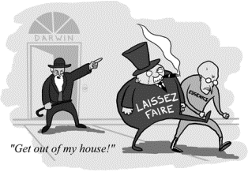
Social Darwinism
The application of the idea of “survival of the fittest” to human affairs. Big business leaders used it to justify efforts to limit competition; businesses that drove out their competitors were the “fittest” and deserved to survive.

Slide 19
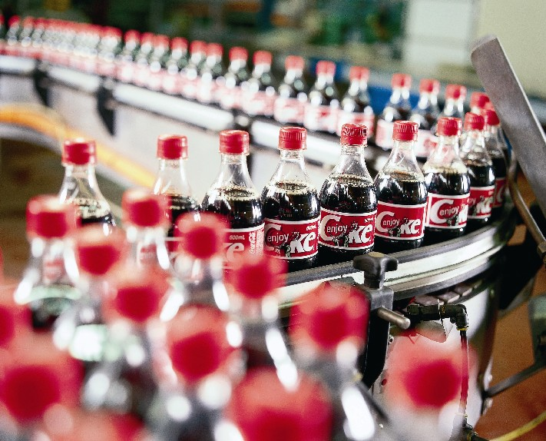
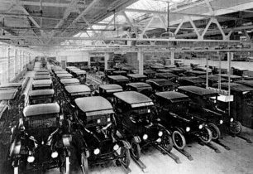
mass production
Making large quantities of product quickly and cheaply.

Slide 20
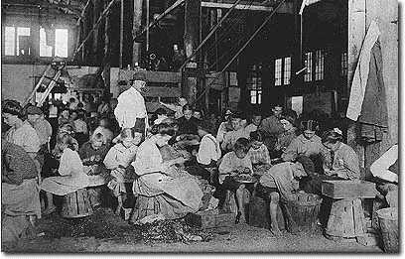
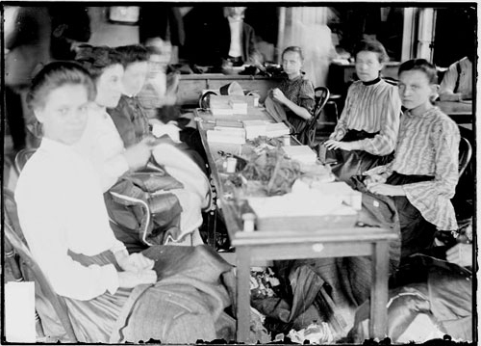
sweatshop
A factory where workers toil long hours under poor conditions for low pay.

Slide 21
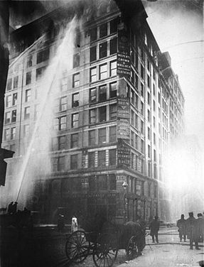
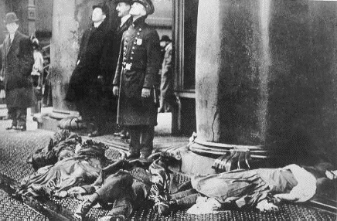
Triangle Shirtwaist Fire
The accident at a New York City sweatshop on March 25, 1911, that tragically called attention to the dangers many workers faced. Nearly 150 people, most of them young women died.

Slide 22
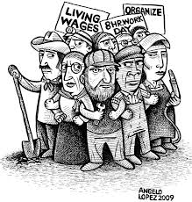
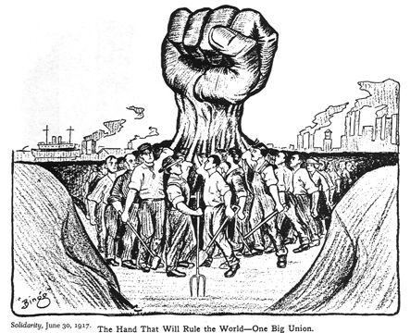
labor union
Organization of workers working together for safer working conditions, higher wages, and shorter hours.

Slide 23
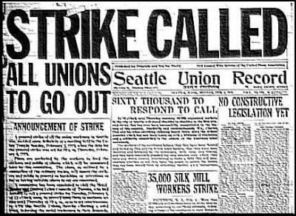
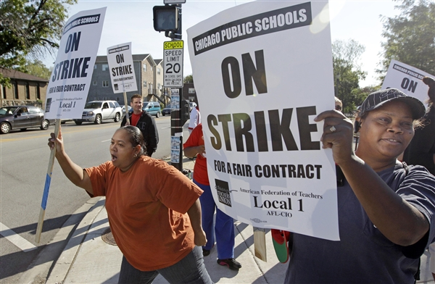
strike
Labor union tactic designed to force employers into making concessions through a work stoppage by employees.

Slide 24
Knights of Labor
Organized in 1869, an early labor union made up of skilled and unskilled workers. It lost much of its influence after the Haymarket Square Riot in 1886.

Slide 25
American Federation of Labor (AFL)
The craft union of skilled workers organized by Samuel Gompers in 1886.

Slide 26
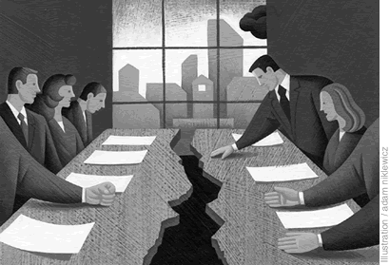
collective bargaining
The method by which workers negotiate with their employers through their union.

Slide 27
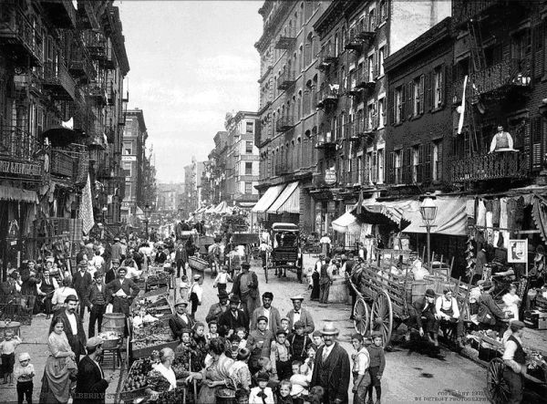
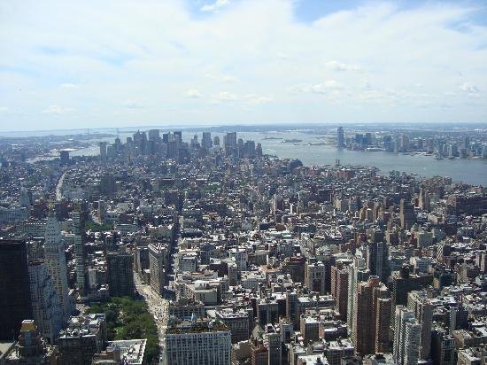
urbanization
The rapid growth of city population.

Slide 28
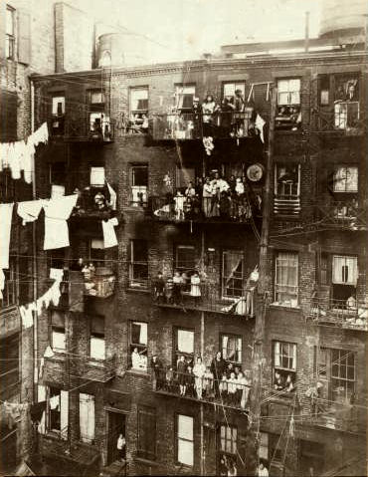
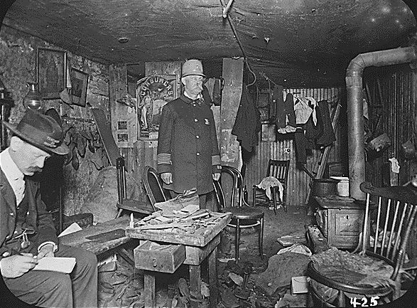
tenements
Buildings divided into many tiny apartments that often had no windows, heat, or indoor plumbing. They were located in the downtown slums and provided housing for the poor.

Slide 29
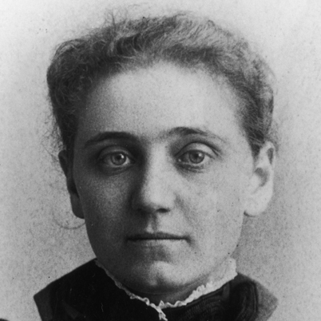
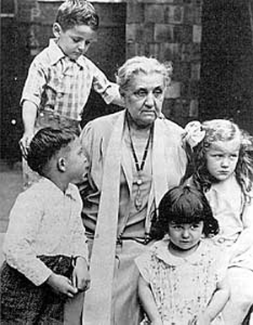
Jane Addams
The urban reformer who founded Hull House in 1889 in the slums of Chicago to help the poor especially immigrants.

Slide 30
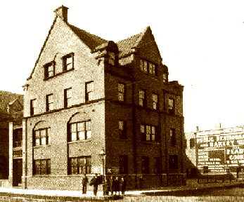
settlement house
A center offering help to the urban poor.

Slide 31
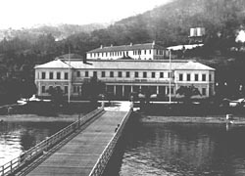
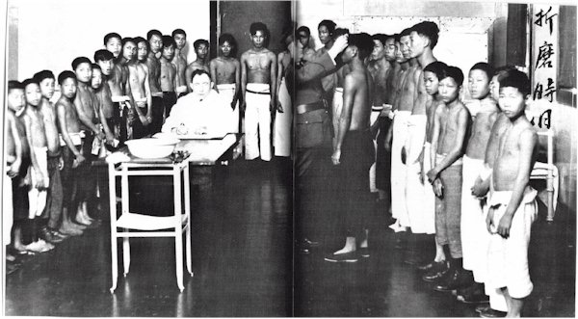
Angel Island
The receiving center for Asian immigrants in San Francisco Bay after 1910.

Slide 32
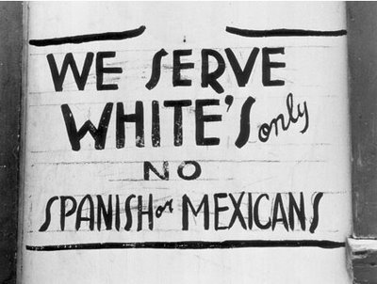
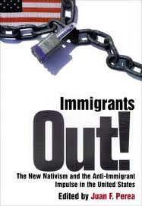
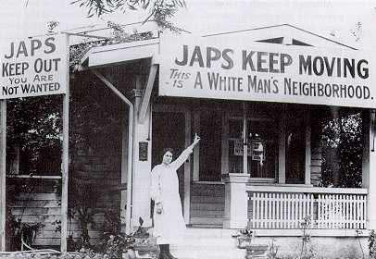
nativism
The policy opposing immigration to the United States; movement to preserve the U.S. for native-born American citizens.

Slide 33
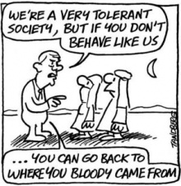
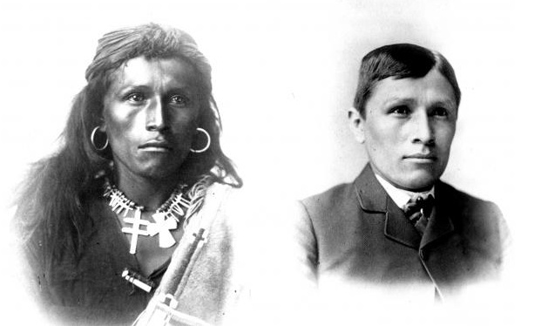
assimilation
The process of becoming part of another culture.

Slide 34
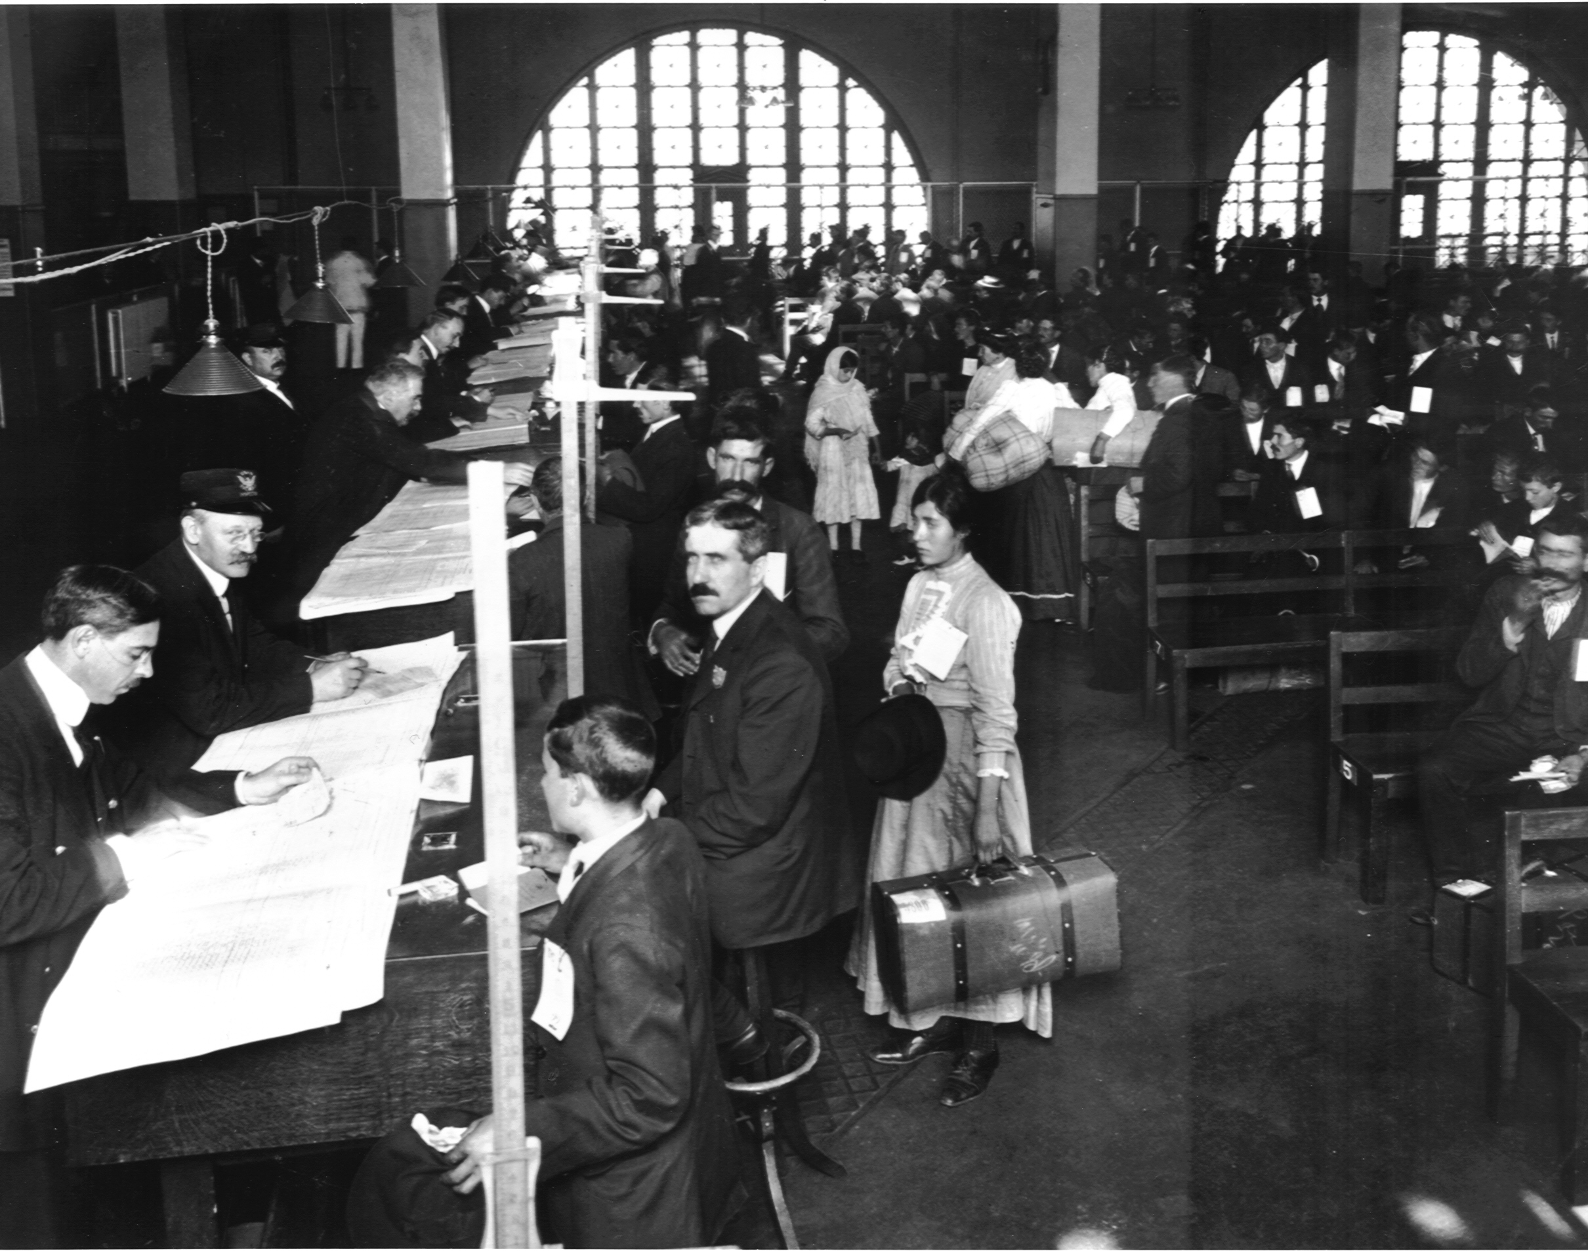
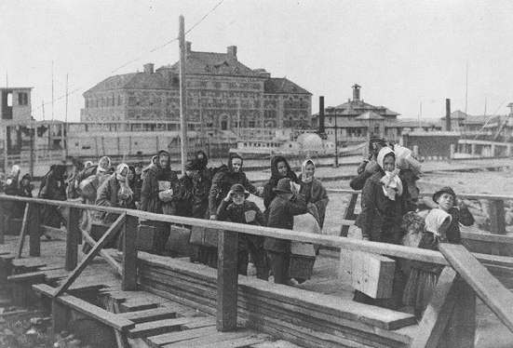
Ellis Island
The receiving center for immigrants arriving from Europe in New York City after 1892.

Slide 35
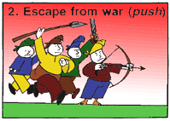
push factors
Conditions that drive people to leave their home country to go elsewhere.

Slide 36
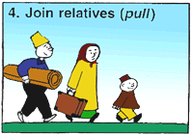
pull factors
Conditions that attract immigrants to a new country.

Slide 37
ethnic group
A group of people who share a common culture.

Slide 38
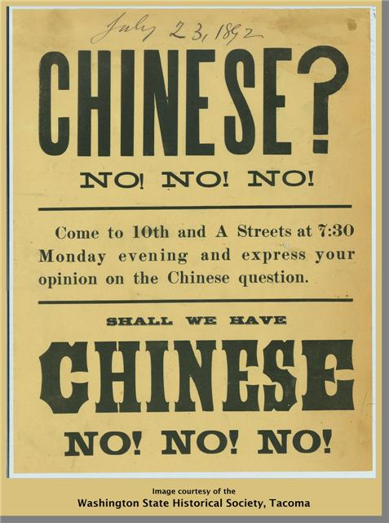
Chinese Exclusion Act
Law passed in 1882 to stop Chinese laborers from coming to the United States. It was the first law limiting immigration based on race.

Slide 39
migrant
A person who moves from one place to another.

Slide 40
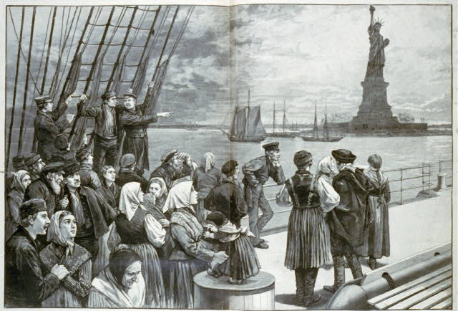
immigrant
A person who moves into a new country permanently.

Slide 41
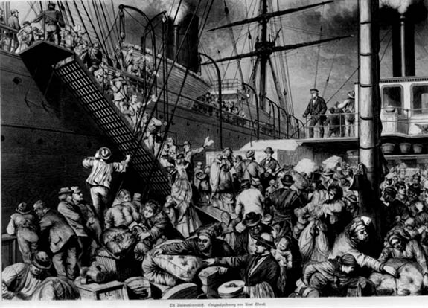
emigrant
A person who leaves from one country permanently to go somewhere else.

